Slide 1
Offensive Technologies
CCTF
Attack Presentation
Group 3
Friday 17 December 2021

Slide 2

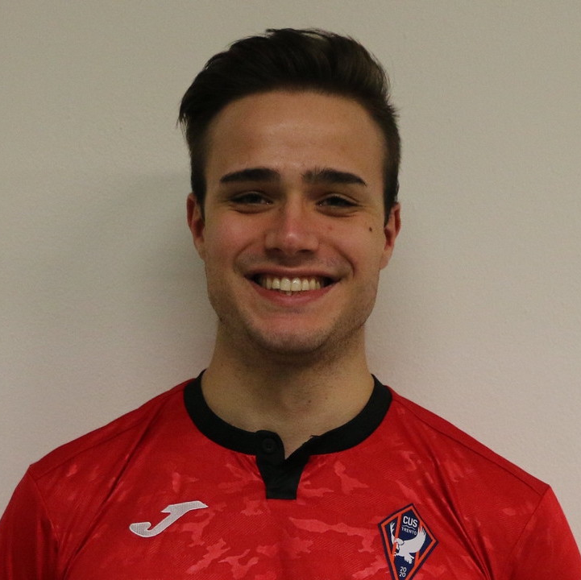
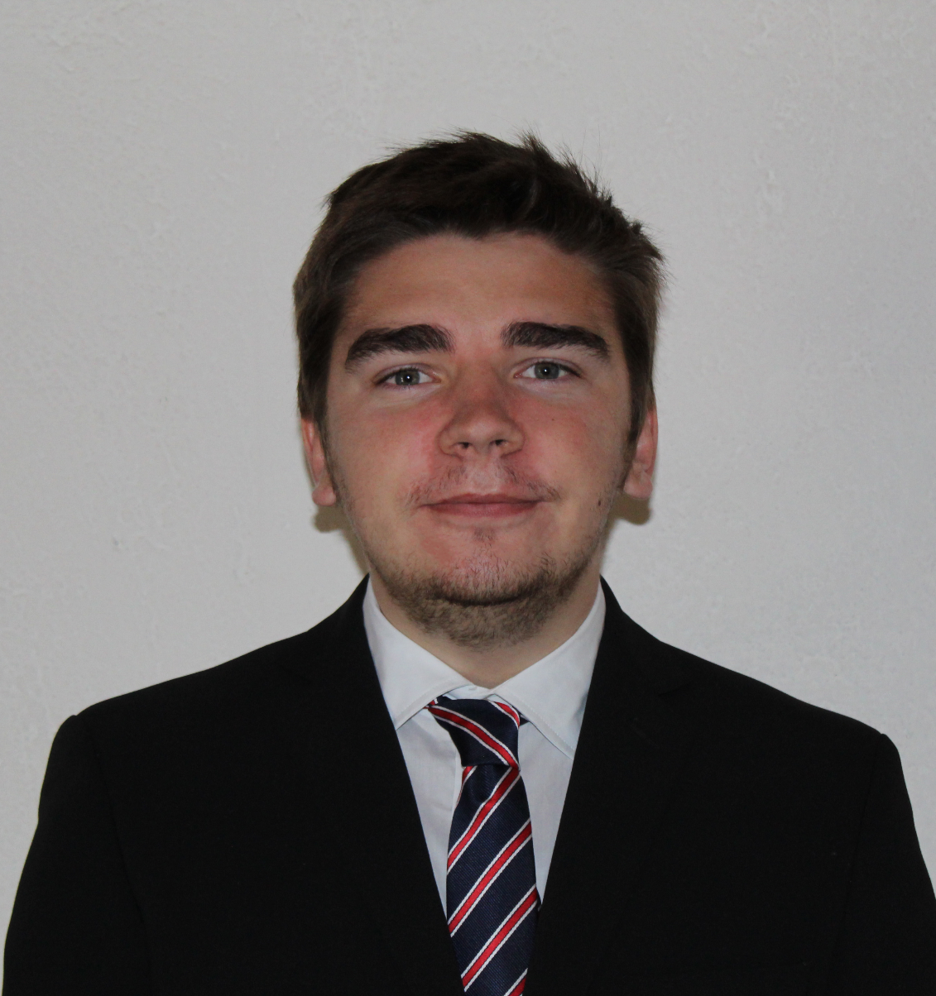

The team that made the dream possible
Lorenzo Cavada
Tommaso Sacchetti
Dmytro Kashchuk
Matteo Franzil

Slide 3

19-11-2021
CCTF Resilient

Slide 4
CCTF Resilient
Context
Goals
Strategy
Configuration
Results
Improvements

Slide 5
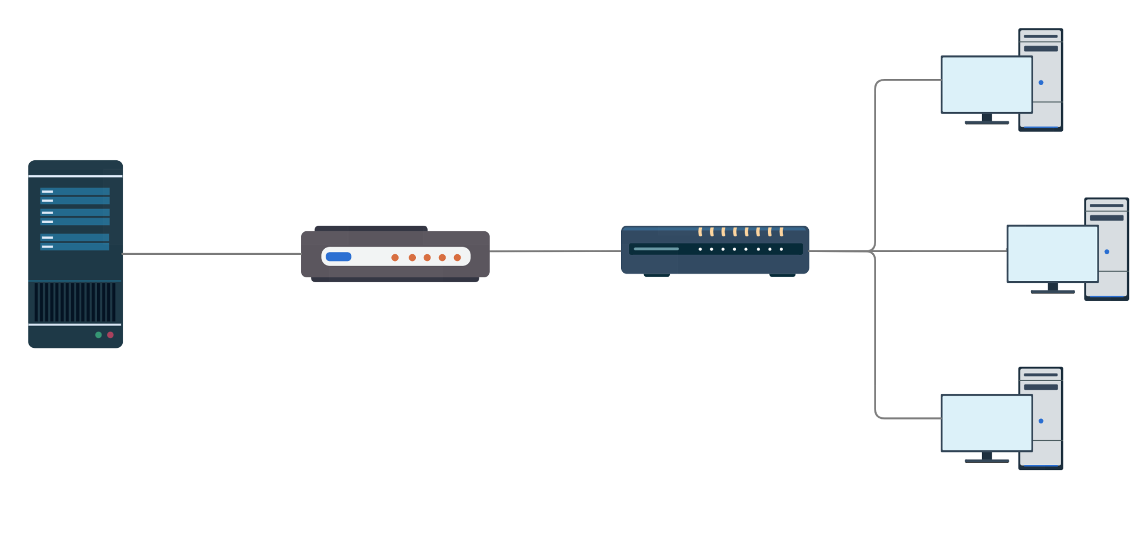
Context
Notes:
Questa è la topologia ma ci passiamo tipo 15 secondi (molto veloce). Il sever fornisce 10 pagine web. Al contempo due dei tre client possono fare ciò che vogliono, mentre uno è legittimo e pinga una delle 10 pagine.

Slide 6
Goals
One of the attacker machines sends legitimate requests to the server
Exhaust server resources
Flood links
Crash the server
Make the server waste CPU cycles, memory and disk space
Stress router-gateway bandwidth by flooding links with crafted packets
With delayed connections, low CPU and memory, the server stops serving pages

Slide 7
Strategy
Reconnaissance
Slow start
Test opposing defenses and capabilities
Trick enemy team by deploying attacks gradually
Part 1
Part 2
Part 3
Part 4
Focus
Wafer smash
Identify key vulnerabilities to exploit
Deploy strongest tools and take down the server
Notes:
Remember to talk about spoofing as the router

Slide 8
Configuration (global)
Shared Git repository
Cloned on each member’s home directory
Automated deployment on each client machine
Centralization of logs and maximum synchronization
Notes:
Citare il fatto che la home è un disco di rete

Slide 9
Configuration
All three clients were configured identically.
GoldenEye
Sockstress
Hulk
Targa3
SlowLoris
hping3
Notes:
Focus su hping3. Ci siamo resi conto verso la fine (della prep) che si poteva spoofare il client legittimo e quindi che potevamo fingere. Da qui ne parla sacca

Slide 10

Loacker
A Go-written program that sends raw TCP/IP SYN packets crafted to look like legitimate curl-created SYNs using all the available bandwidth of a client.
Notes:
LORENZO
Using hping3 we realized that the SYN flood attack was one of our best option, but the main problem with hping was the fact that we could not craft a “realistic packet” since some fields were missing and the difference between a syn packet generated by a curl and the one generated by hping3 were obvious and easy to filter at firewall level.
This is how we thought about LOACKER.
Loacker is a small go program that sends curl-like SYN packets, it is multithreaded and was able to fill all the available bandwidth of the client along with his CPU.
Since those packets really looks like legitimate ones it is almost impossible to filter them out using static rules such as the MSS, etc.

Slide 11
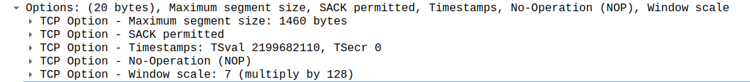
Loacker
Options set up to mock a legitimate SYN packet
Notes:
LORENZO No sack permitted e nop non si possono settare su hping3. Loacker è flessibile

Slide 12

Legitimate
A friendly and helpful cow that every handful of second, makes a legitimate request to the server. Comes packaged with automated logging and time measurement.

Slide 13

Results
Server
After T=2000 s the server started timing out, unable to serve legitimate requests
Links
The opposing gateway-server link was flooded and recovered very slowly
Reactions
Interpolated average response time from the server to the legitimate client, measured from the latter. Data aggregated in ten second batches.
The vulnerability was ultimately fixed and subsequent attacks were less effective

Slide 14
Improvements
The attack could be described as successful, yet:
the defense team used a suspicious sliding source port technique that completely nullified Loacker
a limited toolset and its predictable behaviour reduced the surprise factor
Some key points that could be improved include:
the choice of tactics for spoofing the attacker machines
the investigation on gateway vulnerabilities, overlooked in this CCTF
the reaction time to changes in the defense team setup

Slide 15


10-12-2021
CCTF Secure

Slide 16
CCTF Secure
Context
Goals
Strategy
Configuration
Tools
Results
Improvements

Slide 17
Context

Slide 18
Goals
Compromise the blue team server in order to steal information/money
Exhaust server resources
Steal money
Steal credentials
Make the server waste CPU cycles, memory and disk space (without flooding)
Compromise the database with bogus requests in order to steal money
Obtain sensitive information such as passwords and ask the blue team for a ransom

Slide 19

Strategy (1/2)
Phishing
Focus
Send a fake email pretending to be the TA
Identify key vulnerabilities to exploit
Reconnaissance
Dictionary attack
Test opposing defenses and capabilities
SSH passwords
User passwords

Slide 20

Strategy (2/2)
DB flood
Fuzzing
Register several users
Slow down queries Exhaust server space
Feed the server with crafted query strings
Discovery
Discover deployed pages on web server

Slide 21

Configuration
All three clients were configured identically.
Nmap
Attila
SQLmap
BruteForcer
SlowLoris
emkei.cz

Slide 22

Attila
Like Attila plundered his enemies with his unmatched prowess in battle, attila.sh plundered the enemy database, flooding it with user entries.
An asynchronous and automated Bash function for making both legitimate and malicious server requests, with logging included.

Slide 23
Brute forcer
Identify a registered user in the database by trying to register new user with a common username
Start brute forcing the identified users with the most common passwords
Notes:
LORENZO
First step identify the already existing user -> try to register common users
Second step try to brute force them using common password
No success

Slide 24

Results
2400
users
created
22, 80, 111 gateway ports open
< 5%
storage
wasted

Slide 25

Other “results”
No fish were caught
No input-bugs
detected
All SQLi
blocked
No entry points found

Slide 26
Improvements
The attack did not have any impact. What did go wrong?
we completely missed the exponential log vulnerability
the social engineering attempt was too rushed
very strong defenses from the enemy team mitigated all our attacks
Some key points that could be improved include:
the investigation of system constraints of the server
choosing a different dictionary for the password attacks
being more consistent in the database flooding
using less improvisation and more step-by-step planning

Slide 27
Thank you!

